Slide 1
Wealth & Asset Management
AI orchestration for asset managers, wealth advisors, PE firms & family offices — powered by the #1 iPaaS
Notes:
Slide Structure:
Slide 1: Title + Hook
Title: "Accelerating Banking Operations with AI & Automation"
Subtitle: [Prospect Bank Name] + Workato
Visual: Banking imagery (not stock handshake clichés)
Script: "Thanks for the time today. I want to share how leading banks are using automation to transform loan processing, compliance, and customer experience..."
Slide 2: The Challenge (Industry-Specific)
Headline: "Banks Are Caught Between Growth Pressure and Operational Complexity"
Content (3 visual stats):
📉 "Customer expectations: Same-day loan decisions"
⚠️ "Reality: 7-14 day processing times, 23% abandonment"
💰 "Impact: $4.2M in lost revenue annually for mid-size banks"
Visual: Icons + brief stats (not bullet points)
Script: "What we're hearing from banks like yours: customers expect instant decisions, but manual processes across Salesforce, your LOS, and core banking create bottlenecks..."
Slide 3: The Workato Approach (Solution Framework)
Headline: "Orchestrate Data, Systems & AI Across Your Banking Operations"
Content (3 capability pillars with icons):
🔗 Connect Everything: 1200+ connectors (Salesforce, nCino, Temenos, SAGE, Guidewire)
🤖 Add Intelligence: AI agents for underwriting, fraud checks, compliance
⚡ Empower Teams: Business users build workflows, not just IT
Visual: Simple architecture diagram showing systems flowing through Workato
Script: "Workato sits in the middle, orchestrating data between your CRM, loan origination, core banking, and compliance systems. Your business teams can build and modify these workflows without waiting on IT..."
Slide 4: Proof (Customer Success Snapshot)
Headline: "[Similar Bank/Credit Union] Achieved These Results in 6 Months"
Content (Before/After metrics):
Loan processing: 7 days → 4 hours ⚡
Cost per loan: $450 → $180 💰
Compliance violations: 12 → 0 ✅
FTE redeployed: 15 employees to customer service 👥
Visual: Customer logo + headshot + quote (if approved)
Quote: "Workato gave us the agility to launch new products without rip-and-replace." - VP Digital Banking
Script: "Here's a credit union similar to you in size and tech stack. They were struggling with the same loan processing bottleneck. After implementing Workato..."
Slide 5: Next Steps (Clear CTA)
Headline: "Let's Explore What's Possible for [Prospect Name]"
Content:
✓ Discovery Workshop (2 hours): Map your loan origination process
✓ Value Assessment (1 week): Quantify your automation opportunity
✓ Pilot Use Case (30 days): Prove ROI with one workflow
Visual: Simple timeline graphic
CTA: "Can we schedule a 2-hour workshop with your lending and IT teams?"
Script: "I'd love to do a deeper dive on your specific environment. We typically start with a discovery workshop where we map your current loan process, identify automation opportunities, and build a business case..."
Customization Zones for Partners/Sellers:
Slide 1: Add partner logo (if GSI co-sell)
Slide 2: Swap industry stats (use different challenge if prospect cares more about compliance than loans)
Slide 4: Change customer proof to closest match (community bank vs. regional bank vs. credit union)

Slide 2

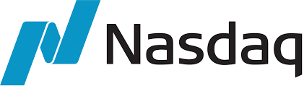
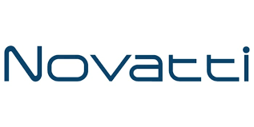

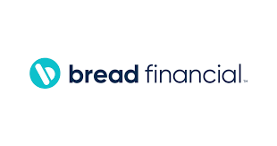
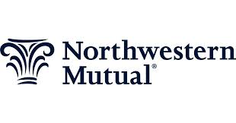
Accounts opened.
Loans approved.
Customers answered.
Work done!
Notes:
Top vertical segment messaging

Slide 3
The data problem is costing you alpha.
Enterprise Agility: 68% of investment technology leaders say data silos are the top barrier to AI deployment. Man Group built AI/NLP help desk triage, LLM orchestration with Python, DevOps CI/CD, and Workday automation — all on one Workato platform. LGT Capital Partners runs 1,448 active recipes — the most of any Workato customer in financial services. Efficiency & OrCA: Portfolio managers spending hours aggregating earnings calls, SEC filings, and custodian data are not doing the work they were hired for. Fidelity generated $90K in immediate savings from automated marketing workflows alone. OrCA scales with AUM and transaction volume — no over-provisioning at quarter-end. Risk Reduction: SEC examiners expect immediate audit trail access. JML failures — departing employees retaining system access for days or weeks — are a material risk in firms with access to non-public information. Man Group provisions and revokes access in hours, not days. Zero Downtime Upgrades mean no maintenance windows disrupting trading operations. Revenue Growth: Post-M&A integration speed is a direct P&L driver. Brookfield Asset Management uses Workato to sync newly-acquired companies in real time. Eagle Point Credit deploys Azure Doc AI + Bloomberg via Workato for AI-powered investment research. Research Genie turns analyst hours into analyst minutes.
LGT Capital Partners: 1,448 active recipes.The highest recipe count of any Workato financial services customer. Axioma, DealCloud, Azure DevOps, Appian — all connected across 3+ business units.
Notes:
Align with Value drivers of WSS.
—--------
Discover time - what are you needed to solve??

Slide 4
Built for the investment management tech stack
Enterprise MCP Server Templates
Turn investment research and portfolio workflows into governed MCP servers. Research Genie synthesizes earnings calls, SEC filings & market data. Full audit trail for SEC readiness.
AI Genies
Research Genie | KYC Genie | Portfolio Reconciliation Genie | JML Lifecycle Genie | Client Reporting Genie | Compliance Filing Genie
Investment Platform Connectors
BlackRock Aladdin | SS&C | Charles River | SimCorp | Axioma | Redtail | DealCloud | Bloomberg (API) | Refinitiv | FactSet | Salesforce FSC | Workday (all modules) | Snowflake | Databricks | Azure DevOps | Appian
Notes:
How do we fit into the Banking ecosystem.
Connectors - Orchestration out

Slide 5
Four priorities. Investment-grade results.
Investment Research Synthesis & AI Analysis
Portfolio Reconciliation & Operations
Client Onboarding & KYC (48-Hour Target)
JML Lifecycle & Regulatory Compliance

Slide 6
Use Case: Investment Research Synthesis with AI
Current: Analysts manually aggregate earnings calls, SEC filings, Bloomberg data. Hours per report. Target: Research Genie synthesizes multi-source data into structured summaries in minutes. Man Group model: ChatGPT + Python/LLM orchestration on Workato.

Slide 7
Why Workato for Wealth & Asset Management

Slide 8
Asset managers running on Workato
Man Group
AI/NLP orchestration + Workday + DevOps + JML on one platform $215K ARR • 650 active recipes • 3+ BUs • ChatGPT + Workday (all modules) + Azure AD + APIM + Workbot + SCIM • JML lifecycle: access provisioned/revoked in hours
LGT Capital Partners
1,448 active recipes — highest in all of FinServ $495K ARR • 3+ BUs • Axioma + DealCloud + Azure DevOps + Appian + Event Streams + APIM • Investment ops, deal pipeline, IT and compliance all orchestrated
Fidelity Investments
$90K immediate cost savings from workflow automation $143K ARR • 40 recipes • Aprimo (marketing automation) + AWS Secrets Manager + WFA + EKM + Data Integration + Event Streams + Audit Streaming • Custom workflow development for GTM operations generating immediate measurable savings
Notes:
Links to each of the customer reference packages.

Slide 9
Man Group: AI Orchestration, Workday & JML — All on One Platform
Challenge: Global systematic investment manager needed to connect Workday (HR/payroll), Azure Active Directory, ChatGPT/LLMs, trading systems, and DevOps pipelines — while ensuring JML lifecycle security for employees with access to sensitive investment data. Outcomes: $215K ARR • 650 active recipes • 3+ business units • ChatGPT + Workday (all modules) + Azure AD + APIM + Workbot + SCIM all active • JML lifecycle: access provisioned and revoked in hours, not days • AI/NLP help desk triage automated • Python/LLM AI orchestration in production • DevOps CI/CD pipeline automated • Salesforce enablement running. Workato how: Workday (trigger: new hire/termination) → Active Directory (access provisioning) → 20+ trading/investment systems (role-based access) → audit trail. POWER differentiator: Zero Downtime Upgrades + Enterprise Security for 24/7 trading operations.

Slide 10
LGT Capital Partners: 1,448 Recipes — Most Complex FinServ Deployment
Challenge: PE and wealth manager needed to connect Axioma (risk analytics), DealCloud (deal management), Azure DevOps, and Appian across 3+ business units — with no unified orchestration layer. Outcomes: $495K ARR • 1,448 active recipes — highest in all of Workato FinServ • 3+ business units • Axioma + DealCloud + Azure DevOps + Appian + Azure Service Bus + APIM + Event Streams all connected • Investment ops, deal pipeline, IT, and compliance data all flowing in real time. Workato how: Axioma (portfolio analytics) + DealCloud (deal data) + Azure DevOps (engineering) + Appian (workflow automation) all orchestrated through Workato. Event Streams for real-time data. APIM for internal API governance. SCALE differentiator: OrCA scales with AUM and portfolio complexity.

Slide 11
Fidelity Investments: $90K Immediate Savings from Workflow Automation
Challenge: Fidelity needed to automate marketing campaign workflows in Aprimo, eliminate manual site creation processes, and build custom GTM operation workflows — without increasing headcount. Outcomes: $143K ARR • 40 active recipes • Aprimo + AWS Secrets Manager + WFA + EKM + Data Integration + Event Streams + Audit Streaming all active • $90K in immediate cost savings from automated site creation workflows eliminating manual processes • Custom workflow development for GTM operations. Workato how: Aprimo (marketing automation) + AWS Secrets Manager (secure credentials) + Data Integration (data pipelines) + Event Streams (real-time triggers). SPEED differentiator: Fast Build + Extensive Connectivity for marketing and GTM workflows. EKM + Audit Streaming active for enterprise security compliance.

Slide 12









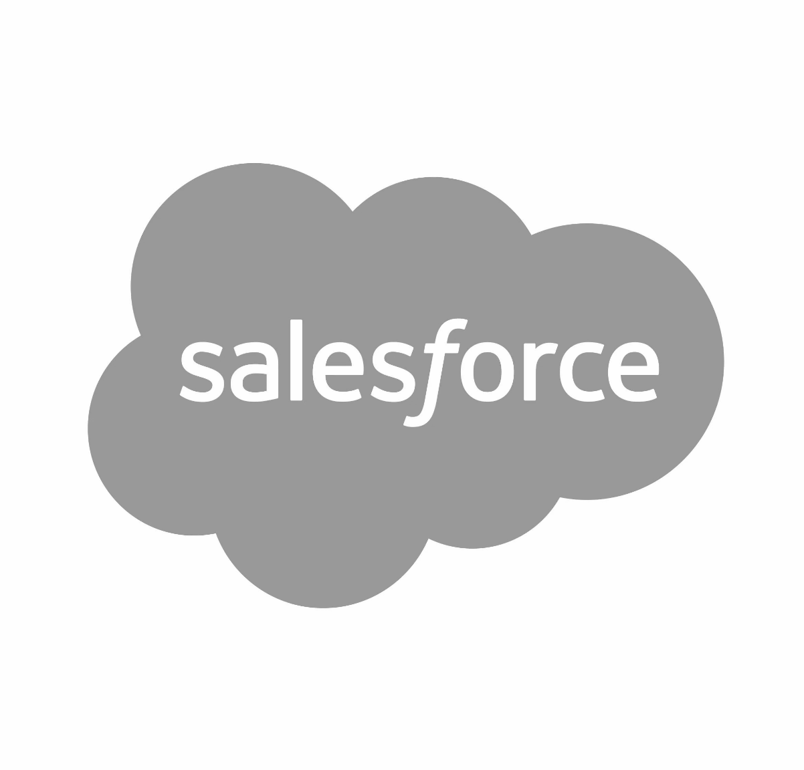



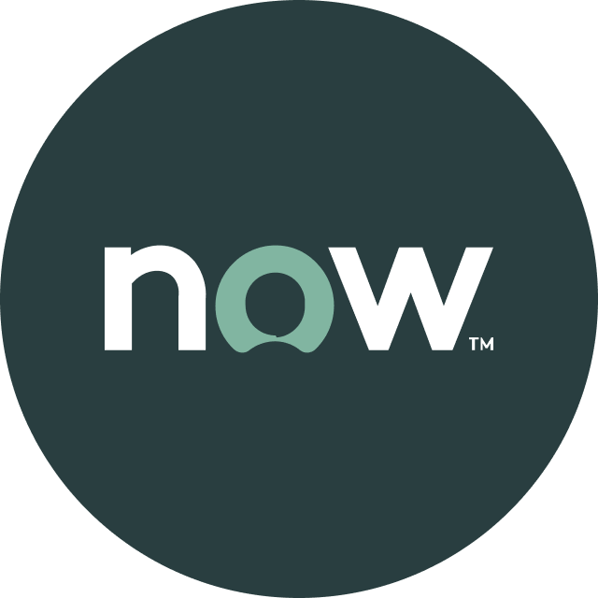
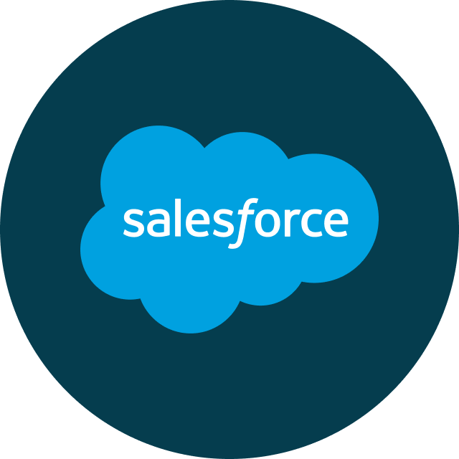
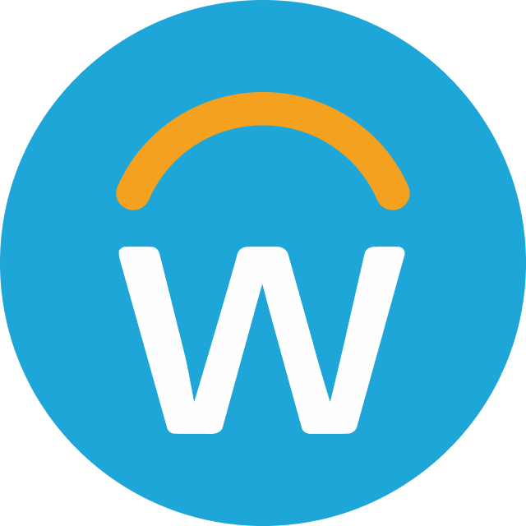
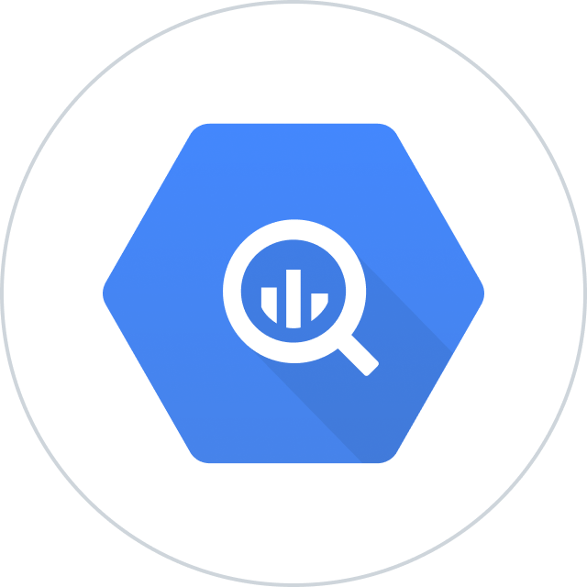


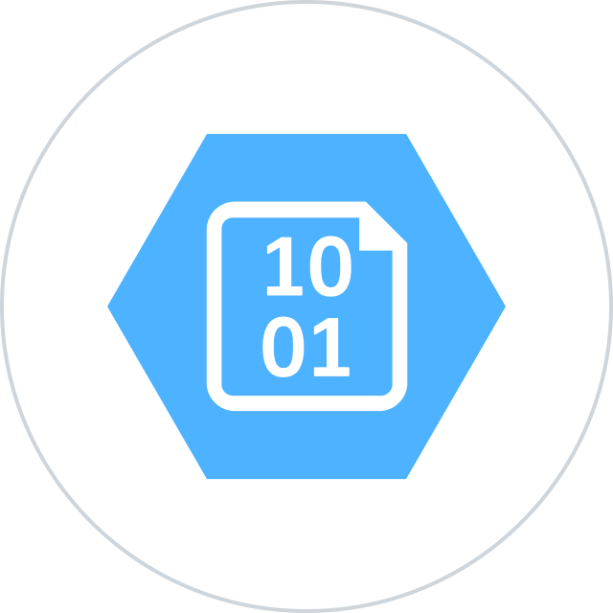
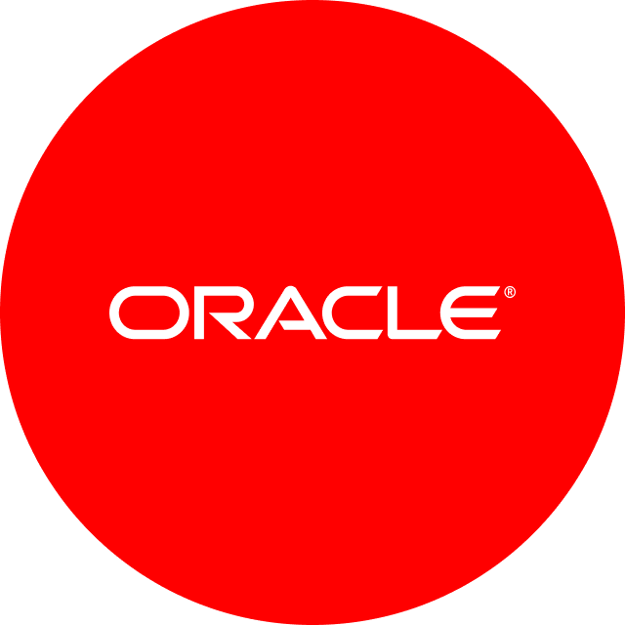

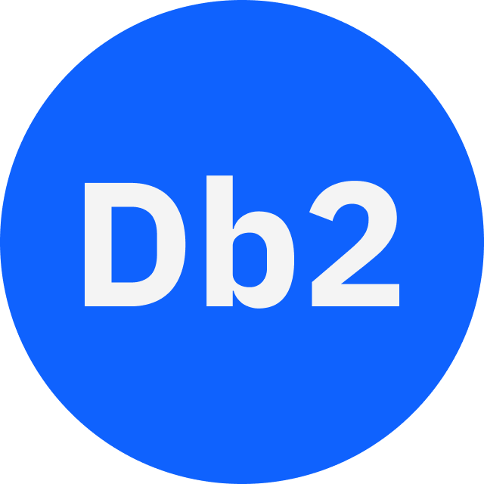




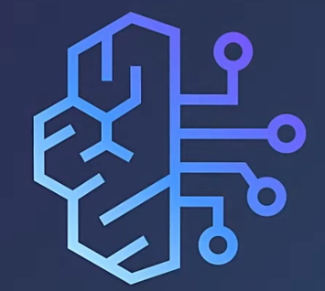
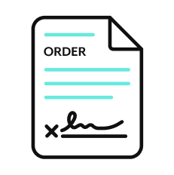


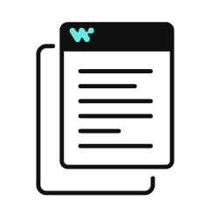




Orchestration for the Agentic Era—Powered by the #1 iPaaS.
I
Build agents with us
Go faster with Enterprise Skill packs and Workato Genies
W O R K A T O E N T E R P R I S E M C P
P L A T F O R M A G E N T S
E N T E R P R I S E S K I L L S
T R U S T
MCP Gateway
Observability
New simpler graphic
Solution Architect (AIRO™)
Skills Builder
MCP Composition
MCP Registry
MCP Proxy
Governance
O R C H E S T R A T I O N
Security
Data Scientist (Acumen)
Process Automation
Application Integration & B2B
Compliance
Data Orchestration
API Management
Explainability
Powered by iPaaS+
U N I V E R S A L C O N N E C T I V I T Y
SaaS/On-prem
Data Warehouse/ Data Lakes
Databases
LLMs
Unstructured
Traditional
Invoice
Media
Transcripts
Contracts
SFTP
Mainframe
Custom
Archives
Notes:
This is Workato ONE —Orchestration for the Agentic Era—Powered by the #1 iPaaS.
Unlike solutions that give you pieces of the puzzle, Workato ONE delivers the complete agentic enterprise:
Workato ONE One platform for data, apps, and agents
Workato GO puts enterprise search with Deep Action™ directly in every employee's hands
Workato Agentic builds and deploys production-ready agents with full enterprise context
Workato Enterprise MCP One trusted bridge for every agent to connect to applications and systems safely and securely
Workato Orchestrate powers complex workflows across teams, systems, and agents
All built on universal connectivity to 10,000+ applications and data sources
What makes this different? True Enterprise Orchestration.
Everyone talks about integration—APIs, MCP, basic workflows. But enterprise orchestration is fundamentally different. It's:
Transactionality that ensures every action completes or rolls back cleanly
In-sequence and exactly-once delivery so your financial transactions never duplicate
Runtime authentication and RBAC that enforces your security policies in real-time
PII obfuscation and data governance that maintains compliance automatically
Event-driven, batch, and real-time triggers that handle any integration pattern
Plus something no one else has: 1 million+ Enterprise Skills—pre-built, production-tested capabilities that encode your business logic, not just API calls. When an agent needs to "process a return," it doesn't just update a field—it orchestrates the entire business process across systems, with all the exception handling, approvals, and compliance checks your enterprise requires.
This unified approach enables true multi-agent orchestration. Your agents don't just connect—they inherit your enterprise's operational intelligence.

Slide 13

Thank you

Slide 14
Appendix of slides

Slide 15
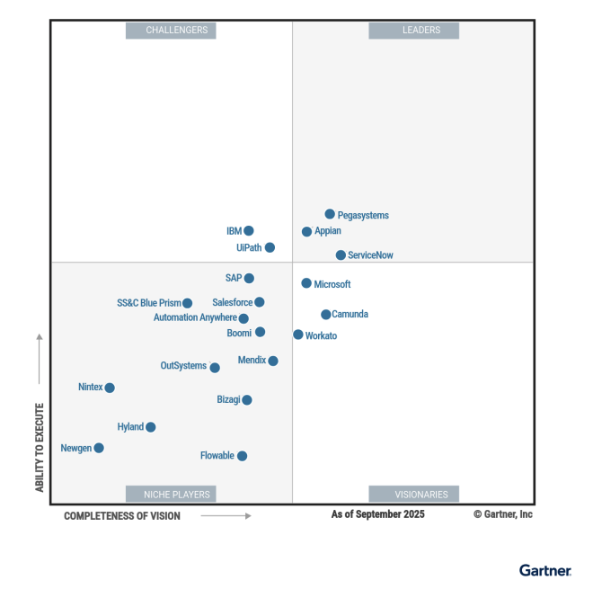
Leader in platforms and orchestration
Gartner iPaas : Leader - 7x
Visionary

